Slide 1
Memory and Multiplexers
Braidan Duffy

Slide 2
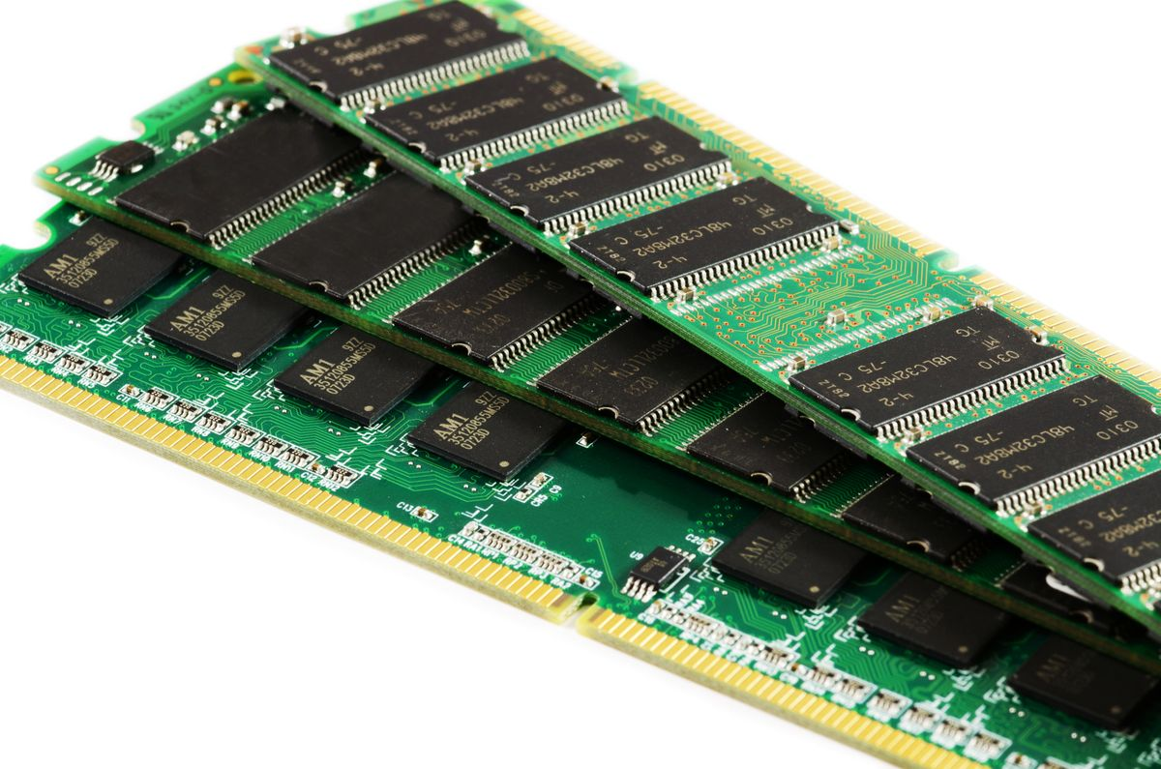
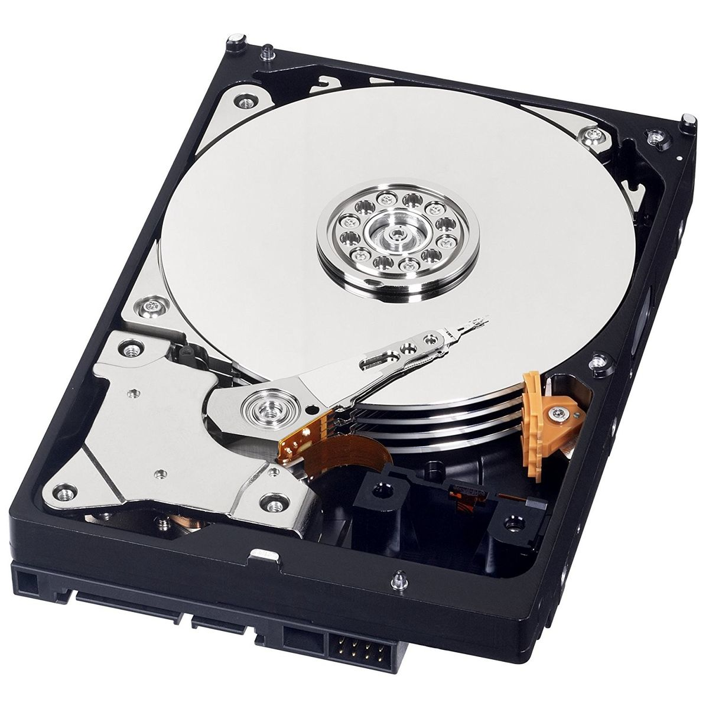
Introduction
Volatile Memory:
Memory that needs power to maintain state
Persistent Memory:
Memory that maintains state without power

Slide 3
Single Bit Memory
Do you remember, the 21st bit of
01010011 01100101 01110000 01110100 01100101 01101101 01100010 01100101 01110010

Slide 4
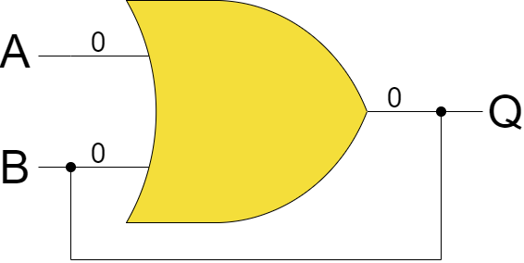
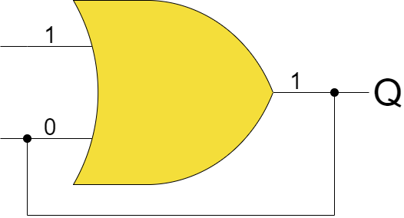
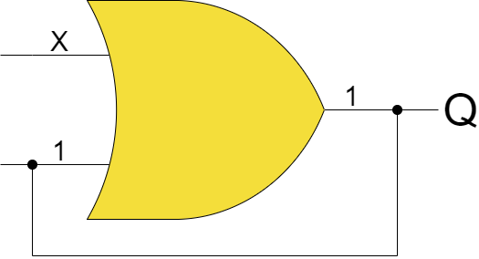
Single Bit Memory
Circuit that can record a “1” however, the change is permanent

Slide 5
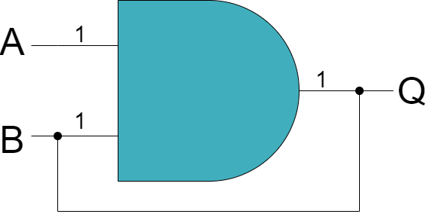
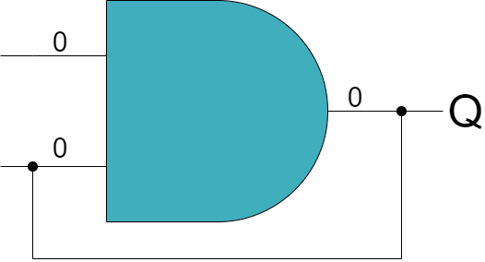
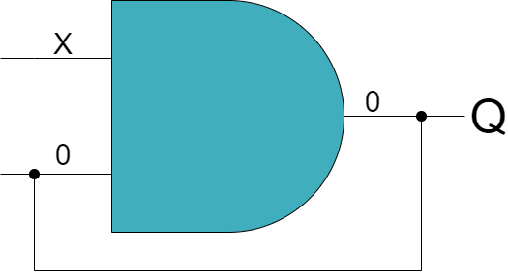
Single Bit Memory
Circuit that can record a “0” however, the change is permanent

Slide 6
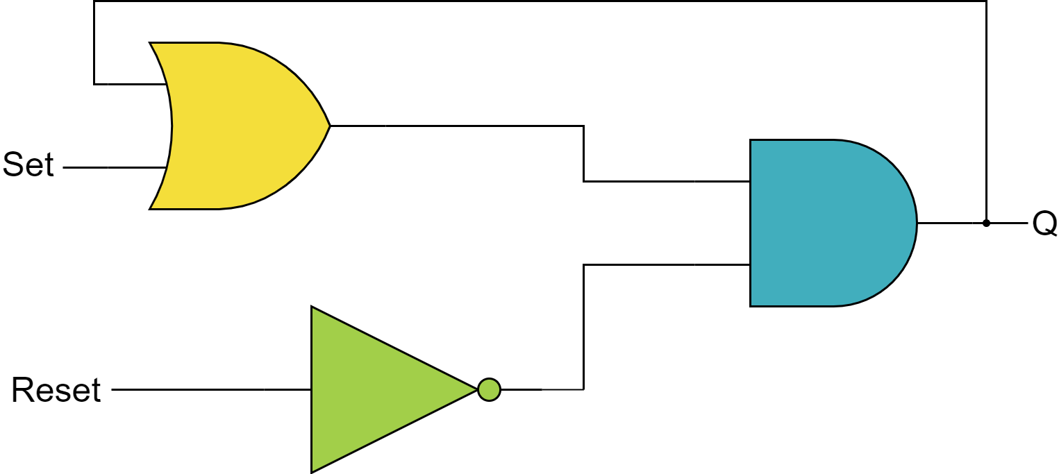
Single Bit Memory
1
1
1
0
1
AND-OR Latch

Slide 7
Single Bit Memory
1
0
1
0
1
AND-OR Latch

Slide 8
Single Bit Memory
Set | Reset | Q
0 | 0 | X*
0 | 1 | 0
1 | 0 | 1
1 | 1 | 0
1
1
0
1
*Will retain last output
1
0
“Latch” – retains value
“Writing” – put data in
“Reading” – get data out
AND-OR Latch

Slide 9
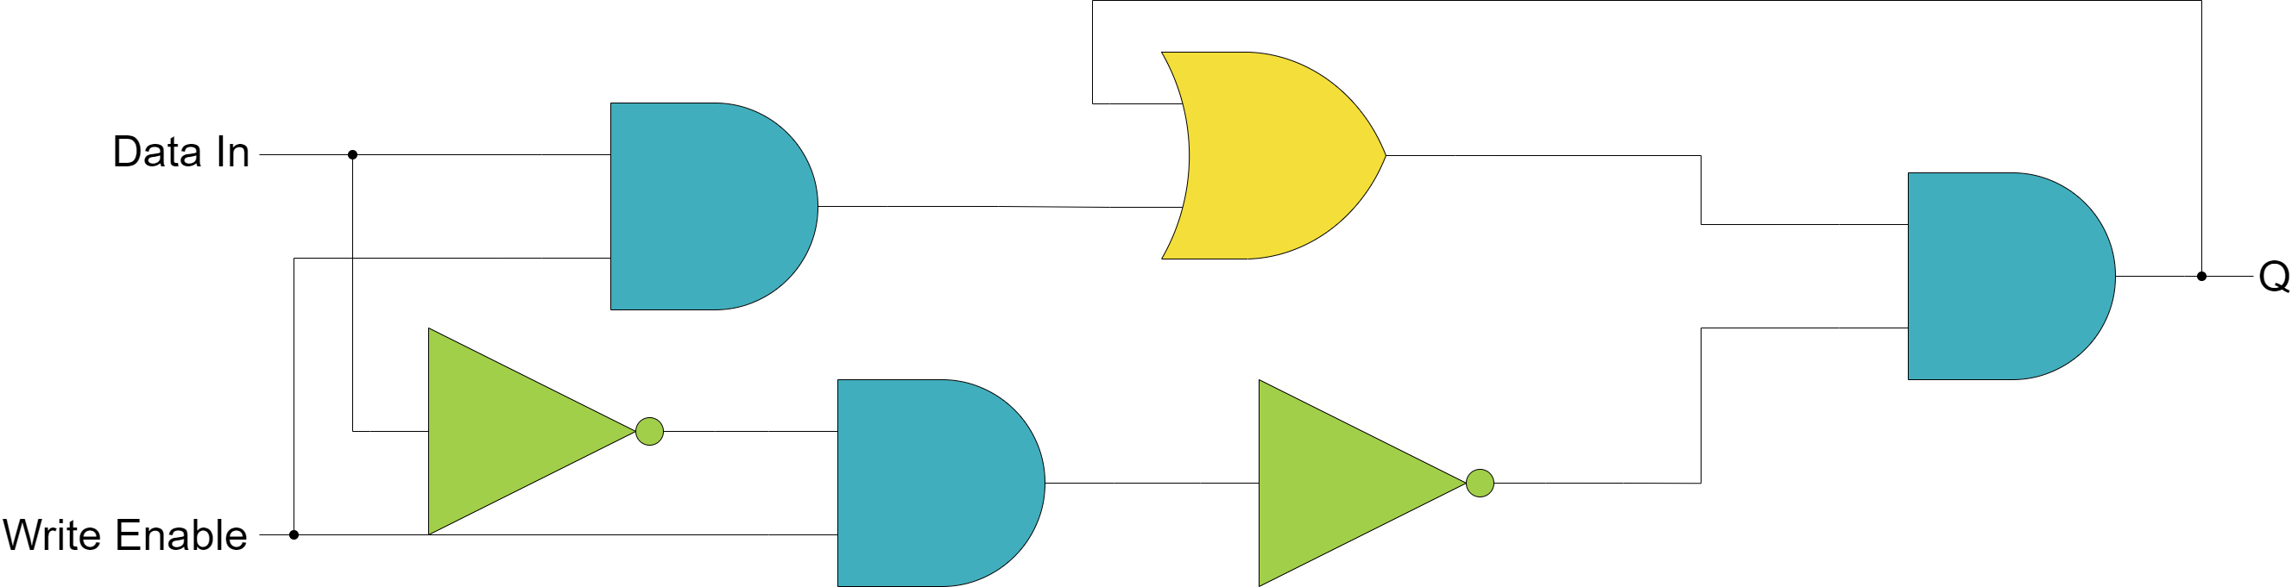
Single Bit Memory
Gated Latch
1
1
1
1
0
0
1
1

Slide 10
Single Bit Memory
1
0
0
0
0
1
1
0
1

Slide 11
Single Bit Memory
0
1
0
1
1
0
1
0

Slide 12
Single Bit Memory
Data In | Write En | Q
0 | 0 | X*
0 | 1 | 0
1 | 0 | X*
1 | 1 | 1
If write is enabled, output will match data input. Otherwise, output will not change!
*Will retain last output

Slide 13
Registers
All your bits are belong to us

Slide 14
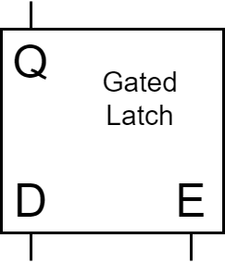
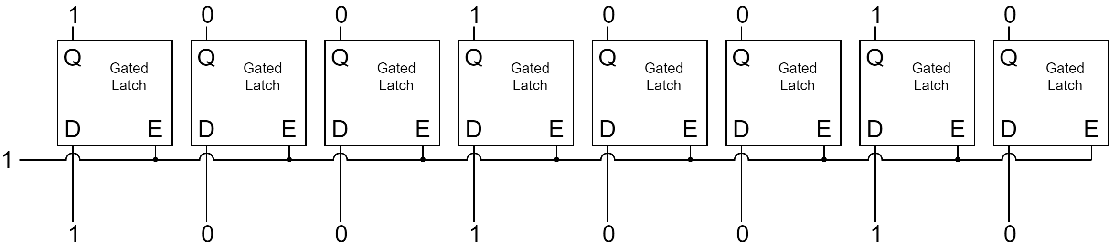
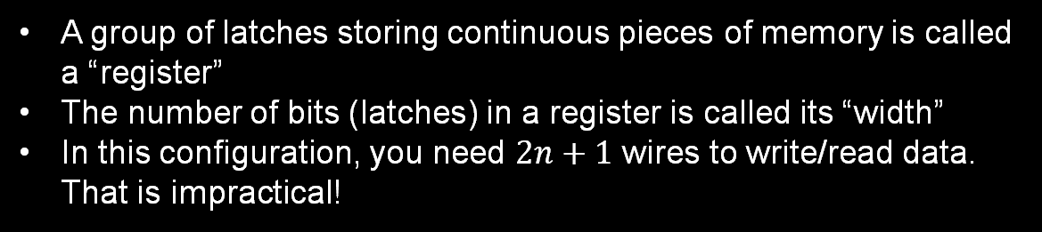
Registers
For simplicity, we are going to place the gated latch into an abstract box
A group of latches storing continuous pieces of memory is called a “register”
The number of bits (latches) in a register is called its “width”
In this configuration, you need $2n+1$ wires to write/read data. That is impractical!

Slide 15
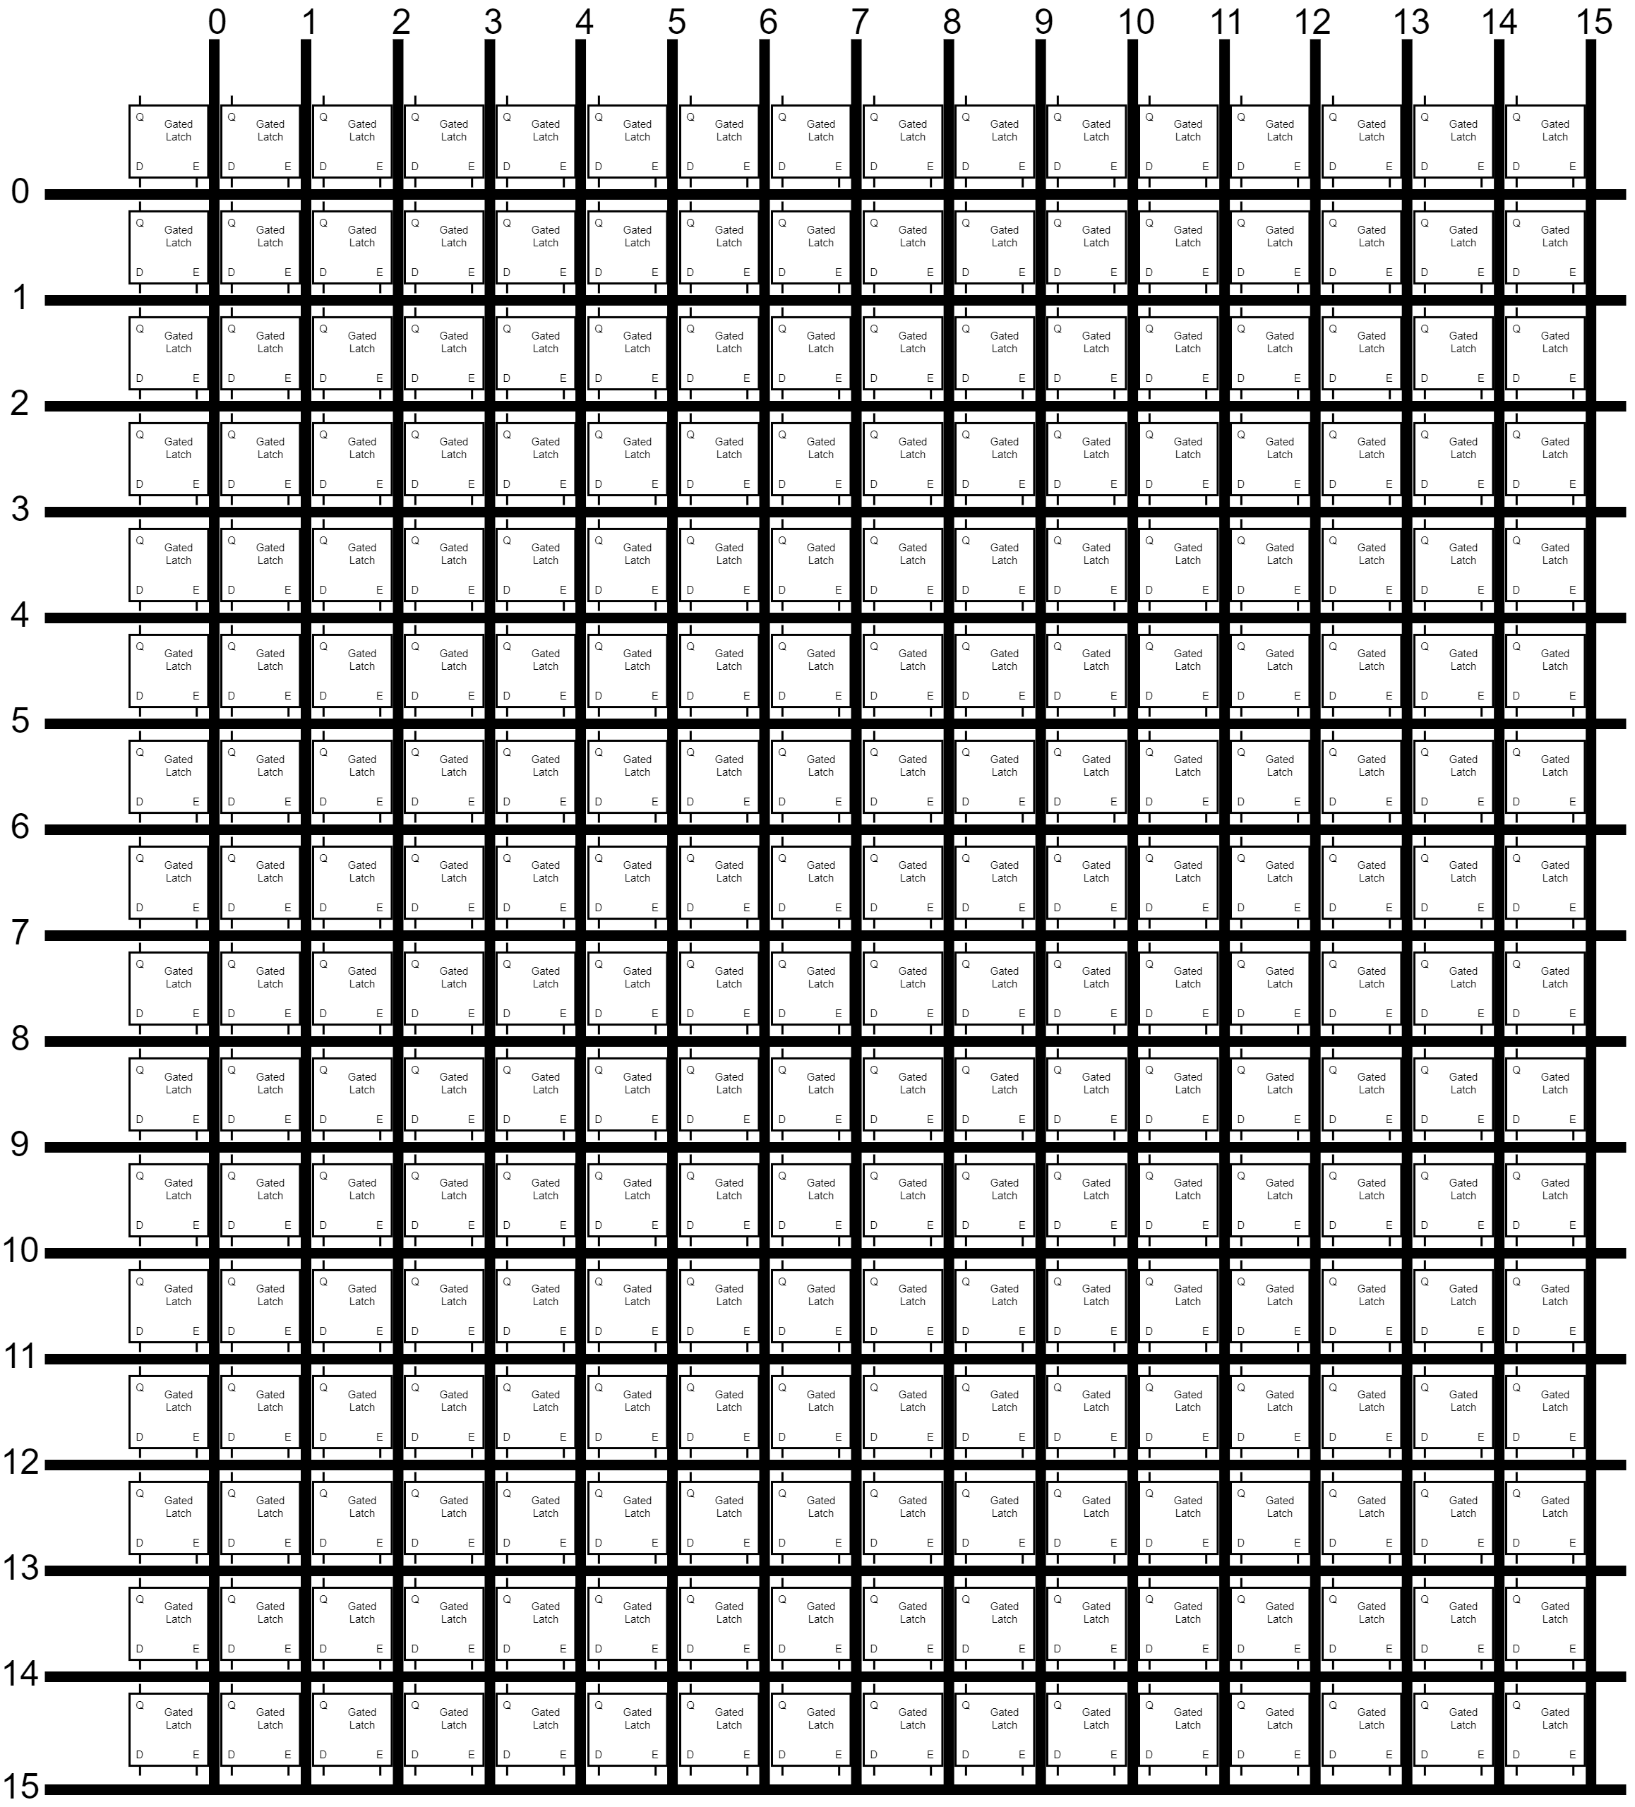
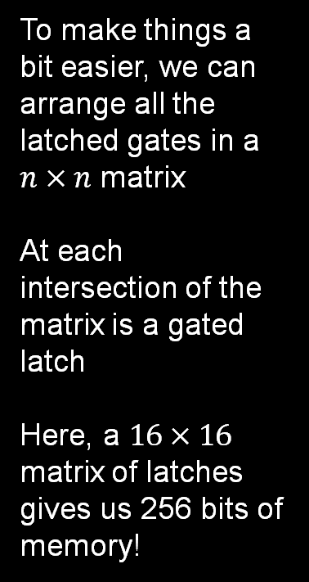

Registers
To make things a bit easier, we can arrange all the latched gates in a $n×n$ matrix
At each intersection of the matrix is a gated latch
Here, a $16×16$ matrix of latches gives us 256 bits of memory!
In this configuration, 256 bits can be controlled with 35 wires
$$(2×\sqrt{n}+3)$$
16 rows,
16 columns,
1 write enable,
1 read enable,
1 data in/out

Slide 16
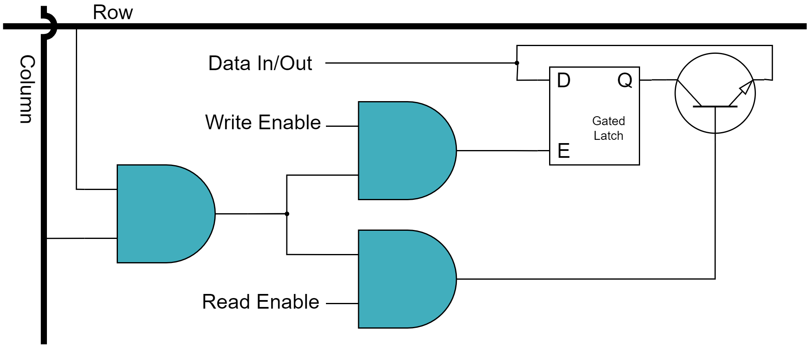
Registers

Slide 17
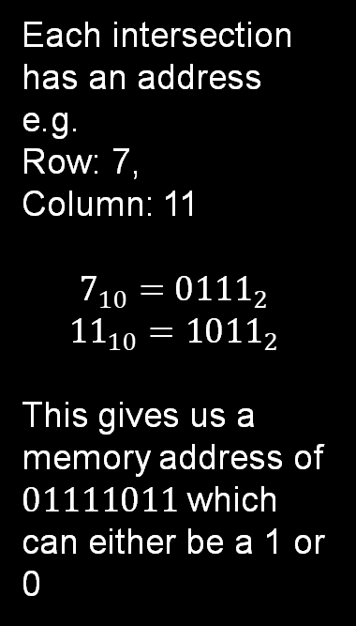
Registers
Each intersection has an address
e.g.
Row: 7,
Column: 11
$$7_{10}={0111}_{2}$$
$${11}_{10}={1011}_{2}$$
This gives us a memory address of $01111011$ which can either be a 1 or 0
To make memory addressing even easier, we can use a multiplexer!

Slide 18
Multiplexers
I mux ask you a question…

Slide 19
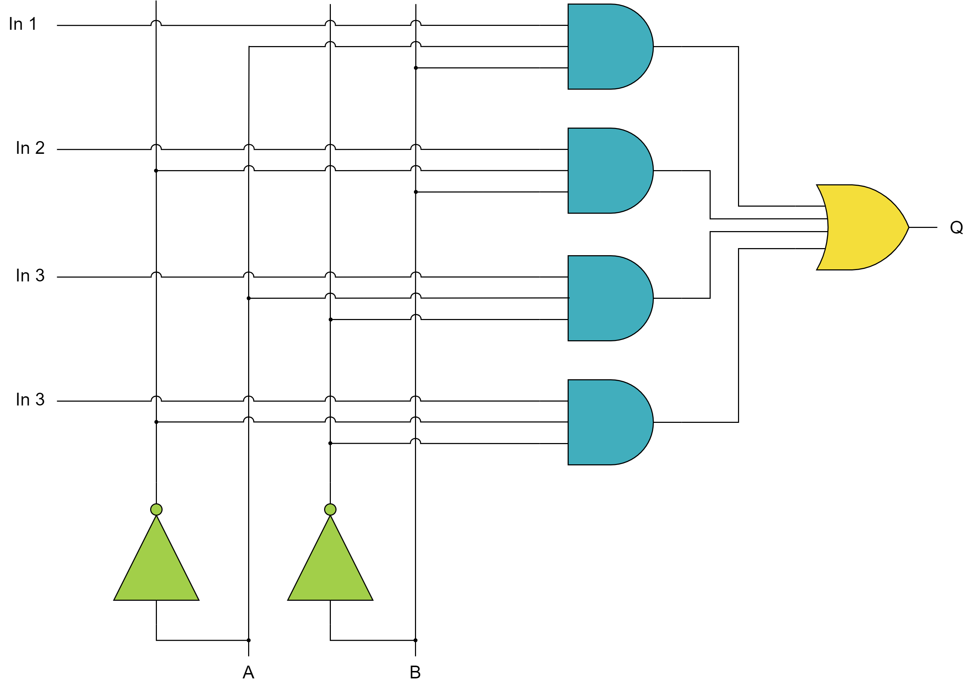
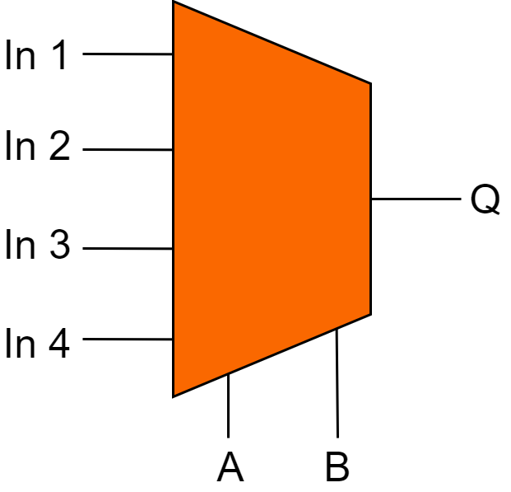
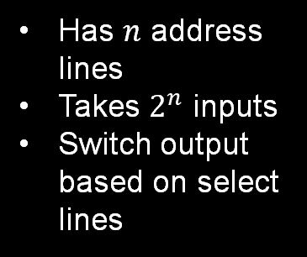
Multiplexers
Has $n$ address lines
Takes $2^{n}$ inputs
Switch output based on select lines

Slide 20
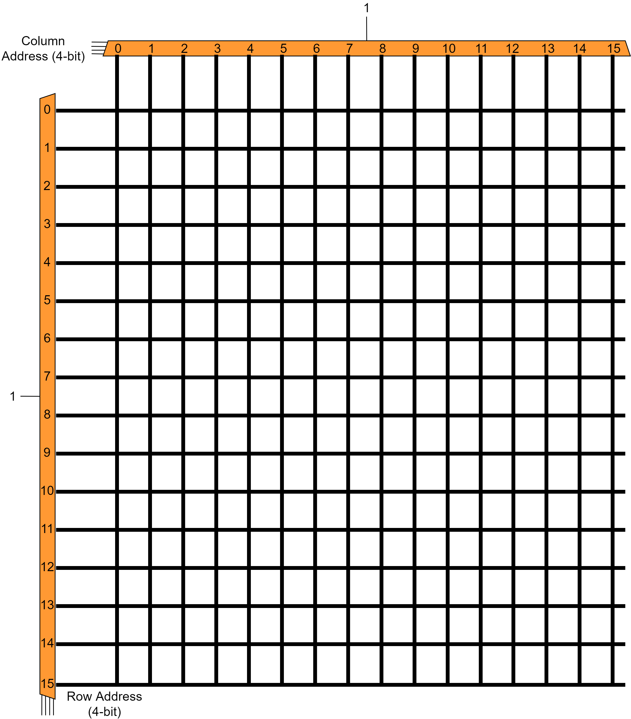
Multiplexers
1011
1011

Slide 21
Memory
I had something for this, but I forgot

Slide 22
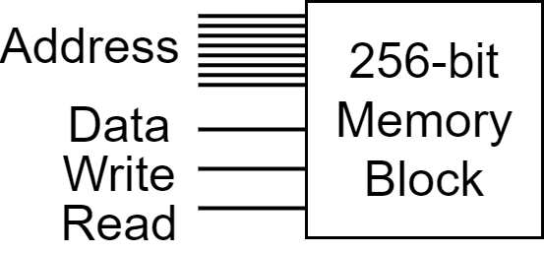
Memory
Another layer of abstraction.
256-bits of gated latch memory represented by a single block with 11 control lines
8 Address lines (4-bit row/col)
1 Data line
1 Write enable line
1 Read enable line

Slide 23
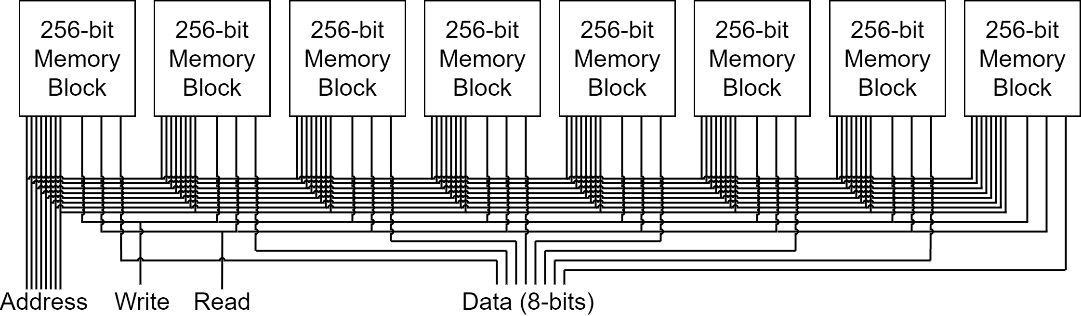
Memory
Stores 1 byte at 256 unique address (256 bytes of storage)

Slide 24
Memory
Address | Data
0000 0000 | 0110 1000
0000 0001 | 0100 0010
0000 0010 | 0011 0111
0000 0011 | 0001 0110
0000 0100 | 0000 0001
0000 0101 | 0010 0011
[…] | […]
We can randomly access any register in memory, hence “Random Access Memory” or RAM
This circuit is called Static RAM or SRAM
We use memory to store numbers, letters, data, information, or system states

Slide 25
Questions?

